Slide 1

Object Oriented Software Engineering Subject: Development Styles Author: Derek Somerville

Slide 2

Admin
Zoom

Slide 3
ILO
To introduce the basic concepts of software engineering;

Slide 4
Coding Styles
Single Person Development
Code Review
Pair Programming
Promiscuous Pairing
Mob Programming
Test Driven Development
Pair Develop and Test

Slide 5




Single Developer

Slide 6
Single Developer
Single Person Development or coding solution
Same person reviewing their code
Same person tests
Same person deploys
One person’s understanding of requirements

Slide 7
Single Developer
What happens if they are sick
What happens when they leave the company

Slide 8
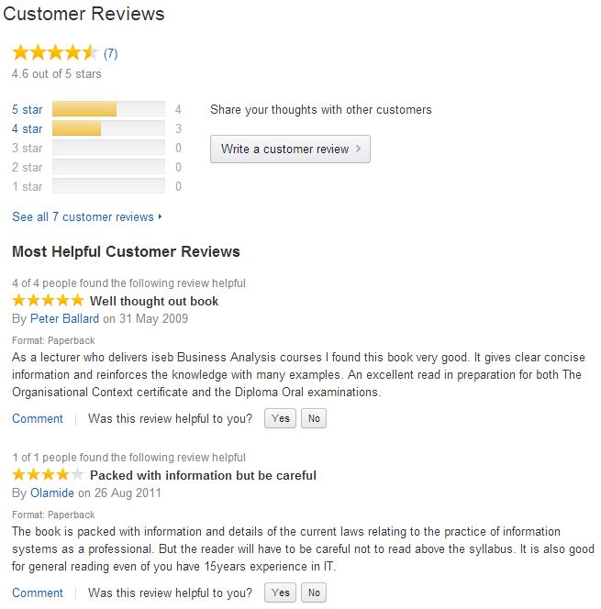

Feedback – E-commerce
Amazon.co.uk customer reviews of Bott’s 1st edn:

Slide 9
Feedback
When have you left feedback or a review? What makes a good review. Have you read reviews and taken notice?
Post to Zoom

Slide 10
Feedback - Solution
Positive review highlight positive points
Constructive feedback, how to improve
Negative review can cause bad feeling, break team moral
Don’t blame

Slide 11
Peer Review - Publishing
An author writes a non-fiction book, and sends a copy to a publisher.
The publisher sends copies to 2 or 3 peer reviewers.
Reviewers are experts in the subject area.
If the reviews are sufficiently favourable, the publisher agrees to publish the book, but requires the author to address any criticisms.
If the reviews are unfavourable, rejected book.

Slide 12
Peer Review - Research
UK research council to fund a proposed project, sends copies 3 peer reviewers.
If the reviews are all favourable, the research council agrees to fund the project (subject to sufficient funding being available).
If even one review is unfavourable, the research council rejects the project.

Slide 13
Peer Review - Research
The quality of research in each UK university is assessed, subject-by-subject, by peer reviewers.
This happens every 5–6 years.
The results drive universities’ funding for research infrastructure.

Slide 14
Source Code Review
What are some of the advantages and disadvantages of source code review?
Post to zoom.

Slide 15
Code Review – Solutions Benefits
Check easy to read and maintain
Highlights mistakes
Avoid duplication
Shared Knowledge
Ownership
Encourages smaller functional units
Reviewer learning coding styles and techniques

Slide 16
Code Review – Solutions Costs
Takes time
Animosity
Can cause blame culture
Can break team moral

Slide 17
Code Review
One developer writes the code
One or more different developers review the code and give feedback
Google has Novices doing code review, it is seem as a learning process
Expert reviews can cause bottle necks
Area owners for components of an application focusing on reviews

Slide 18




Code Review

Slide 19
Coding Styles – Pair Programming
One Driver – creating and typing the code
One Observer – watch and looking for mistakes, discussing points
Single monitor, screen share
Frequent change, every 30 minutes

Slide 20
Coding Styles – Pair Programming
Expert with Expert
Expert with Novice
Novice with Novice
Background knowledge of components to change

Slide 21
Coding Styles – Pair Programming
In-person, both sitting at the same desk
Remote, done using a virtual tool with driver and observer in different locations
Simultaneous Editing – Virtual remote locations with individuals changing the same code

Slide 22
Simultaneous Editing
Terminal Multiplexer
Live-sharing through IDE

Slide 23
Coding Styles – Pair Programming
Analysis of the problem independently and then discuss
Design solution, try to find problems with proposed solution
Implementation - Observer and Drive code the solution

Slide 24
Pair Programming - Benefits
Shared Knowledge
No single point of failure
Improve quality
Observer highlights errors early
Joint discussion of best solution
Team building through collaboration

Slide 25
Pair Programming - Costs
Longer to develop, with discussions
More resources
Can be dead time if driver ignores the observer
Disagreements on solutions

Slide 26
Pair Programming - Findings
Works better with junior developers
Works better on areas with lack of experience
Time taken and quality higher
Development effort higher
Good Agile team players work better, anti-social or egotistical programmers poor
Scheduling can be an issue, time zones
Notes:
Senior can get slower pair programming when they have experience

Slide 27

Pair Programming

Slide 28
Pair Programming
Do not force software engineers to do pair programming
Encourage it
Notes:
Senior can get slower pair programming when they have experience

Slide 29
Coding Styles – Promiscuous Pairing
One driver
Multiple different observers
One at a time
End to end development different experts
Getting to know the team

Slide 30
Coding Styles – Discussion
Break into your MS Team lab groups
Appoint a chair and scribe
What coding style appeals to you and why?

Slide 31
Coding Styles – Mob Programming
One Driver – writing the code
Multiple Observers, discussions
Frequent change

Slide 32
Coding Styles – Mob Programming
Can be time consuming
Good for production issues all hands to deck

Slide 33
Coding Styles – Test Driven Development

Slide 34
Test Driven Development– Unit Tests
Individual Methods or Functions
Very specific use case
Focus on inputs and outputs

Slide 35
Test Driven Development– Write Code
Write code to pass the test
Write no more
Run test and write code till it passes

Slide 36
Coding Styles – Refactor
Code reuse – make use of methods that do the same thing
Can you split a method if it does more than one
Removing duplicate code
Simplify the code
De-coupling – remove dependencies to other items
Cohesion – Make each method/class do one thing well

Slide 37
Coding Styles – Test Driven Development

Slide 38
Pair Develop and Test
Pair look at and discuss solution
One developer codes a solution
One tester created the unit tests
Independence of test
Challenges assumptions

Slide 39
Coding Styles
Single Person Development
Code Review
Pair Programming
Promiscuous Pairing
Mob Programming
Test Driven Development
Pair Develop and Test

Slide 40

Lecture – Any Questions

